Slide 1
Gen AI-Based Email Classification and OCR

Slide 2
Team Members
Fahadh Kasala - K096002 - DTI
Thirumagal Dhivya - U840726 - DTI
Durairaj Jaishankar - U790580 - TCOO
Karthikeyan M - K039576 - TCOO

Slide 3
01
High volume of servicing requests through emails with attachments
02
Manual triage process is time-consuming and error-prone
Challenge Overview
03
Need for automated classification and data extraction
04
Context-based data extraction from email bodies and attachments
05
Detect and avoid duplicate email threads

Slide 4

Solution Overview
Automated Email Classification
Utilizes Generative AI models (LLMs) such as Llama 3 from Ollama for accurate email classification and data extraction.
OCR and Text Parsing
Leverages OCR to extract text from documents and perform text parsing to identify relevant fields.
Data Enrichment and Duplicate Detection
Incorporates data enrichment and duplicate email detection to enhance accuracy and reduce redundancy.

Slide 5

Tech Stack and Tools
Backend and Model Integration
Backend developed using Python with NLTK and Ollama API for Llama 3 integration.
Frontend and User Interface
Gradio UI enables interactive model execution and result visualization.
Database and Deployment
Supabase PostgreSQL for data storage and Docker for consistent deployment.

Slide 6
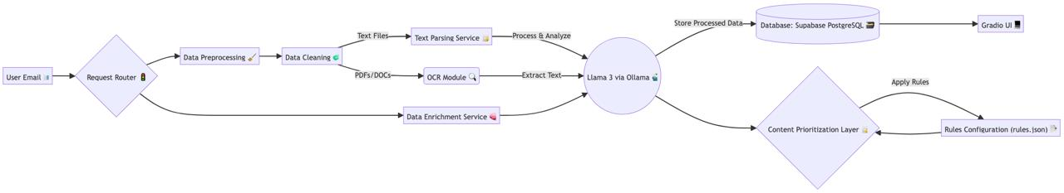
Architecture Flow Diagram

Slide 7
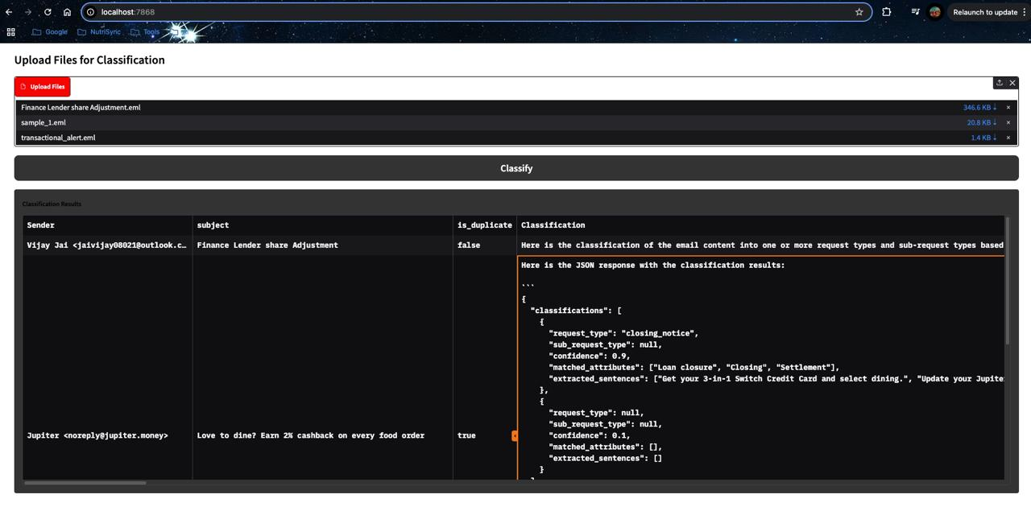
Email Classification Results

Slide 8
Future Scope:
Optimize the prediction accuracy by fine tuning the LLM model with loan servicing related data.
Enhance the duplication detection semantically.
Introduce the reinforcement learning to the models.
Work on Non Functional Requirements like caching the response in cache instead of DB , multi processing the emails.

